Slide 1



×
Workspace DYNAMICS
NDD ORBIX · PARTNER PITCH DECK
Orchestrating The Workspace.
Maximizing Profitability.
A single SaaS platform that monitors and manages every device and service across the digital workspace — turning fleet data into fewer costs, stronger margins, and happier customers.
25,000+
$25M+
500+
End customers · 43 countries
2025 SaaS revenue
Partners worldwide
Prepared by Workspace Dynamics — Official NDD Orbix Distributor · October 2026
01

Slide 2





×
Workspace DYNAMICS
THE COMPANY
Global Scale, Built For Reliability
NDD operates NDD Orbix, a high-availability SaaS platform for managing the devices and services that make up the modern digital workspace — with continuous monitoring that keeps availability high, security tight, costs down, and operations aligned with ESG commitments.
25,000+
$25M+
650+
500+
End customers using our platforms — in 43 countries, 28 of them across EMEA & APJ.
In 2025 NDD sold more than $25 million of software as a service.
Talented colleagues driving innovation, technology, and support.
Partners operating globally with NDD solutions.
1.6 Million Trees Planted. Carbon offsetting through our Green Carbon sustainability project — ESG built into the platform's own operations, not just the customers it serves.
02

Slide 3
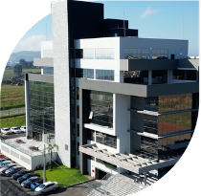



×
Workspace DYNAMICS
GLOBAL FOOTPRINT
A Global Platform, Close To Home
Headquartered in Brazil, with international offices, R&D, and support reaching every market the platform operates in.
Global Headquarters
International Headquarters
Brazil
Portugal · United States · Spain
Research & Development
Support Centres
Brazil · Spain
Regional coverage across the platform's footprint
NDD Headquarters
Lages, Santa Catarina · Brazil
Live In 43 Countries
28 of them across EMEA & APJ — spanning the Americas, Europe, Africa, and Asia-Pacific.
03

Slide 4




×
Workspace DYNAMICS
THE PLATFORM
Meet NDD Orbix
A high-availability, cloud-enabled SaaS platform built for manufacturers, integrators, and print service providers delivering Workspace and Workplace as a Service. It monitors and manages every device and service across the digital workspace, turning fleet data into the insights that drive productivity, reliability, and lower costs.
Personal Devices Management
Automation Devices Management
Computer Control
Print Control
Printer Management
“Not five tools. One console.”
Fully modular — adopt the pillars you need, when you need them, all under Platform Essentials: identity & access, dashboards, reporting, alerts, and open integrations.
04

Slide 5

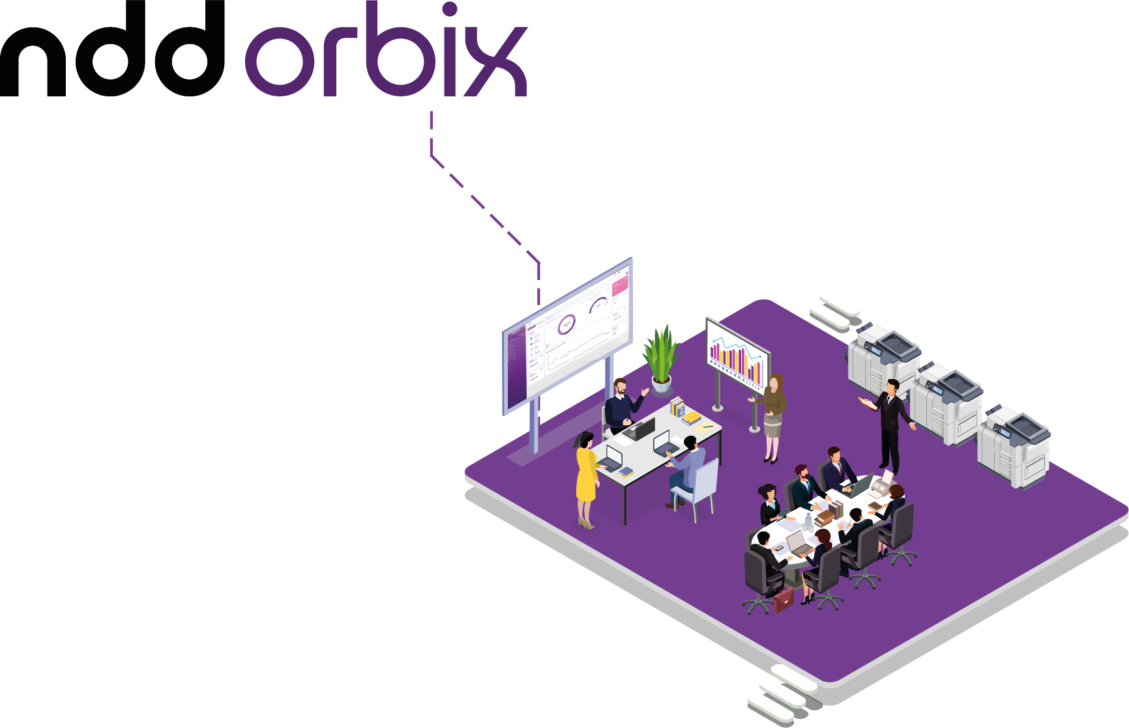
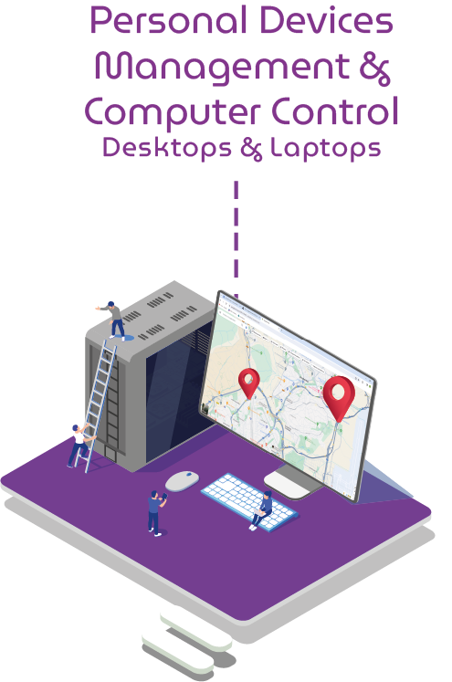
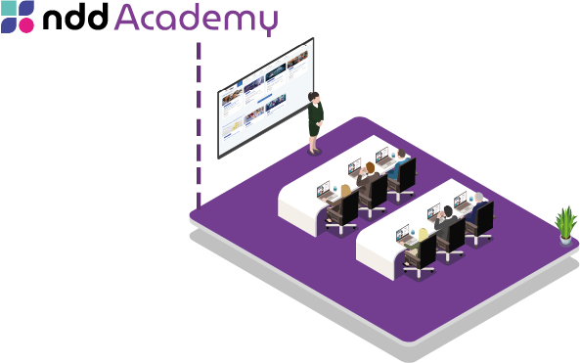

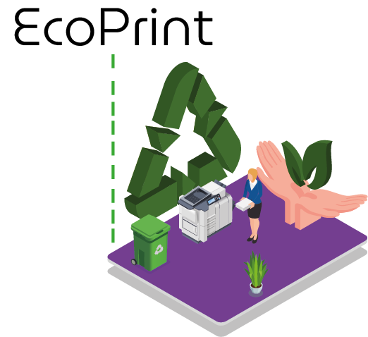
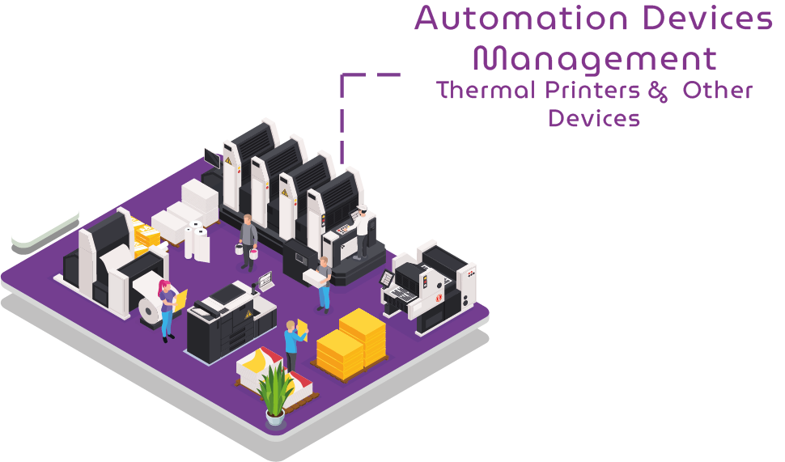
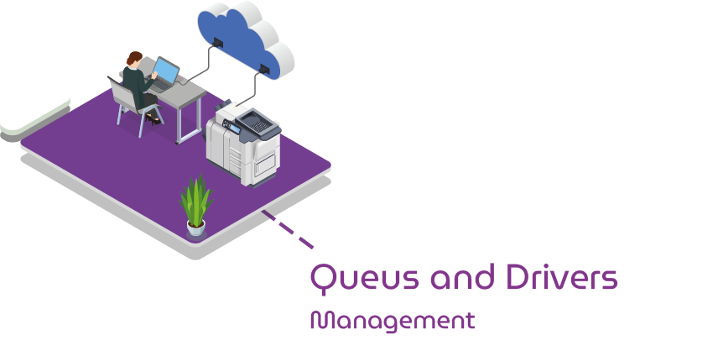
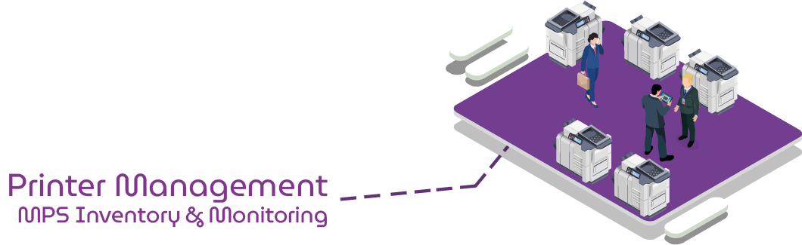
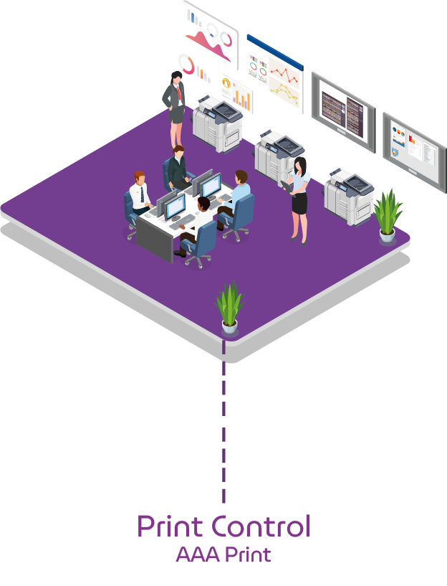
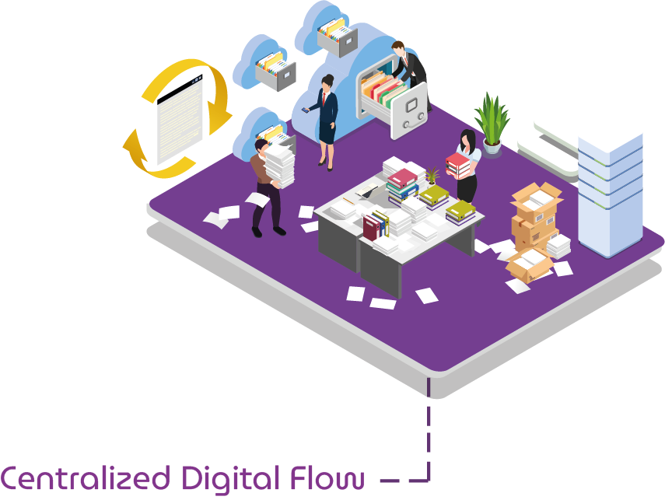


NDD created a platform
to help overcome these challenges
NDD Orbix is a high available platform, SaaS​ and cloud enabled, aimed at manufacturers, integrators and print service providers, Workspace and Workplace as a Service. It monitors and manages multiple devices and services transforming data into strategic insights to increase productivity, reliability and intelligent operations; reducing costs and enhancing revenues.

Slide 6






×
Workspace DYNAMICS
THE PLATFORM
Five Pillars, Working As One
Personal Devices Management
Automation Devices Management
Computer Control
Print Control
Printer Management
Computer inventory & monitoring
Device inventory & monitoring
Geolocation
Label printer inventory & monitoring
Collector inventory & monitoring
Odometer management
Predictive supply intelligence
Software inventory & monitoring
Geolocation
Vulnerability monitoring
Job accounting by user
Policies & quotas
Embedded accounting & authentication
Scan-to-user & digitization workflows
Pull printing & secure release
Cloud printing & retention
Printer inventory & monitoring
Accounting management
Predictive supply intelligence
Remote queue administration
EcoPrint toner saver
PLATFORM ESSENTIALS · SHARED AND INTERCHANGEABLE ACROSS EVERY PILLAR ABOVE
Identity & Access
Remote Installs
Dashboards
Report Generator
Integrations API
Alerts & Workflows
Business Analytics
06

Slide 7





















×
Workspace DYNAMICS
WHY NDD ORBIX
Nine Reasons This Platform Wins
Lowest Disconnection Rate
Print Governance & Access Control
Increased Profitability
Continuous monitoring through a unique agent — others see disconnections of up to 30%.
Strict control over who can print, and where, aligned to your security policy.
Up to 20% savings on consumables, without compromising quality.
Increase In Sales
Monitoring & Security
Reduces Implementation Costs
Security policies, print quotas, and Pull Printing become new revenue lines.
Real-time geolocation, hardware/software inventory, and vulnerability monitoring.
Remote, fast print-queue installs keep drivers current with far less manual work.
Elimination Of False Alerts
Support For USB & Multi-Device
Optimization & Sustainability
Smarter consumables intelligence cuts unnecessary shipments and waste.
The only multi-brand platform guaranteed to manage USB and non-networked devices.
Up to 20% less consumable waste, with environmental-impact monitoring for ESG.
TRULY MULTIBRAND FLEET CONTROL — CERTIFIED COMPATIBLE WITH
07

Slide 8




×
Workspace DYNAMICS
NDD PRINT MANAGEMENT
The Power Of NDD Print Management
Accounting Accuracy
Multivendor Support
Easy Deployment
Captured directly from the device, not the spooler — the most accurate technology in the market.
One user experience across every manufacturer a reseller supports.
Pre-install in the lab with a single unified agent for monitoring and Pull Print.
Less Infrastructure
High Redundancy
USB Monitoring
Pull Print with no print server — or a lightweight serverless option — cuts costs.
The best redundancy technology in the market, with in-memory caching.
Every USB-connected device tracked in the same single platform.
Digital Workflows
Unique Architecture
Mobility
Personalized capture with on-screen metadata and OCR, integrated with DMS/ERP/CRM.
Flexible deployment — local, hybrid, or fully in the cloud.
Email Print, Web Releaser, QR code, and a native mobile app for iOS and Android.
08

Slide 9




×
Workspace DYNAMICS
SUSTAINABILITY & SAVINGS
NDD EcoPrint — Control Toner, Reduce Cost
EcoPrint lightens every printed page at a configurable level — starting at just 1% and adjustable up to 60% — without a visible change in quality.
Four Layers Of Savings
Prove It With Dashboards
1
Lower toner consumption per page
2
Fewer cartridge replacements
Track results through custom dashboards and reports — how many pages were printed, and which printer performs best with EcoPrint — so savings are provable, not just promised.
3
Lower logistics costs
4
Better contract margins
EASY TO DEPLOY. EASY TO PROVE.
Easy Configuration
Toner Supplies Intelligence
Before/After Data History
Works With Every Manufacturer
Manage any number of printers remotely, all at once.
See which brands deliver the most savings, and cut costs further.
Track every customer running EcoPrint and prove the optimization.
Runs on any printer with a PCL6 driver — no exceptions.
09

Slide 10
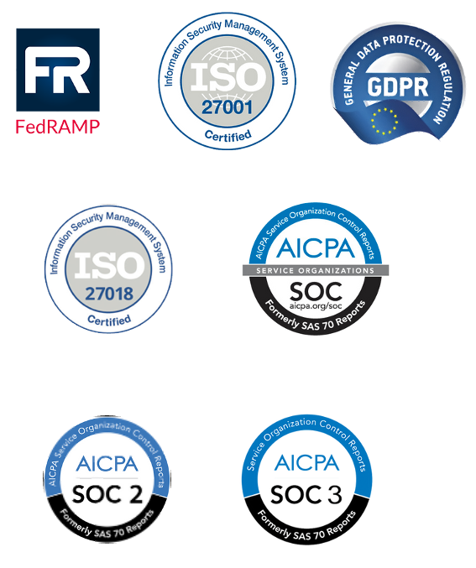


×
Workspace DYNAMICS
SECURITY & COMPLIANCE
Enterprise-Grade Security, By Design
Data Center
NDD Orbix runs on Microsoft Azure, benefiting from its extensive portfolio of security-compliance certifications — covering data processing and storage from design through implementation. Azure's environment also complies with European Union data-protection regulations.
Hardware & Network Security
Every interaction with NDD Print's MPS software runs over secure HTTPS with TLS. The primary domain is authenticated by a Verisign certificate, and no servers are shared between customers.
Data Encryption
Hard drives and backups are encrypted and can only be restored with keys stored off-site — protecting against data loss even in a worst-case scenario.
10

Slide 11
×
Workspace DYNAMICS
PROOF AT SCALE
Trusted By Organizations Worldwide
A sample of the 25,000+ end customers already running NDD platforms.
Vodafone
Toyota
Santander
Walmart
BBVA
Costco
Renfe
Petrobras
Burger King
Renault
25,000+
43
500+
End customers
Countries in operation
Partners worldwide
11

Slide 12
×
Workspace DYNAMICS
THE BUSINESS CASE
Calculating A Conservative ROI
Modeled on a 100,000-device Managed Install Fleet (MIF) — a deliberately conservative view of what NDD Orbix alone can save.
Total Conservative Savings
At A 100K MIF
€3,663,000
per year, across seven conservative line items.
Interested in a detailed ROI calculation specifically for your organization? Let's talk.
12

Slide 13
NDD ORBIX × WORKSPACE DYNAMICS · PARTNER PITCH DECK
Let's Put The Whole Platform To Work
One platform, proven in 43 countries — ready to go to work for your customers, backed by a distributor that knows it inside out.
Workspace DYNAMICS
Hendrik van Oosteren · hendrik@workspacedynamics.tech
Pedro Prieto Simon · NDD
13

