Slide 1




Orchestrating the Workspace and Maximizing profitability
JAN | 2026
V. 03

Slide 2



Orchestrating the Workspace and maximizing profitability .
A new level in device management .​
We manage​ complete digital space – Workspace and Workplace – ensuring efficiency , cost reduction , increased profitability​ and operation continuous multiple​ devices and services , with a focus in productivity , reliability and safety to meet to the demands of your business as provider and its customers finals

Slide 3
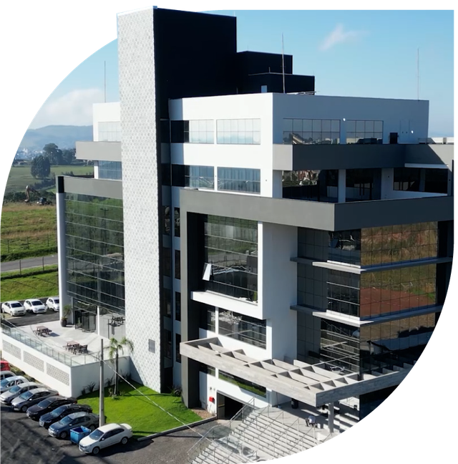
A journey that began in 2004 and revolutionized the way of doing managing Workspace and Workplace devices
6,000 m² of area built , powered by solar energy and reusing water supply​.
  With roots in Brazil, we have expanded to 5 continents, and we transformed into one global technology company .
  Our headquarters in Brazil coordinates with our EMEA APJ headquarters in Spain, and for the Americas in the USA, our operations internationally and our presence in 43 countries.
NDD headquarters in Lages, Brazil.

Slide 4



25,000+
End customers using our platforms in 43 countries,
28 of which are in EMEA & APJ
$ 25 Million+
In 2025 NDD sold more than 25 million $ of software as a service (Saas)
We are a global technology company that operates NDD Orbix, a high availability platform for automation and management of digital environments (Workplace as a Service). We offer continuous monitoring of multiple devices and services, ensuring availability, security, cost reduction and alignment with ESG practices.
650+
Talented colleagues ensuring innovation, technological evolution and support
ESG
As a purpose in the portfolio of solutions ensuring governance and sustainability
500+
Partners operating globally with NDD solutions
1.6 million
Trees planted for carbon offsetting​ through our Green Carbon sustainability project.

Slide 5
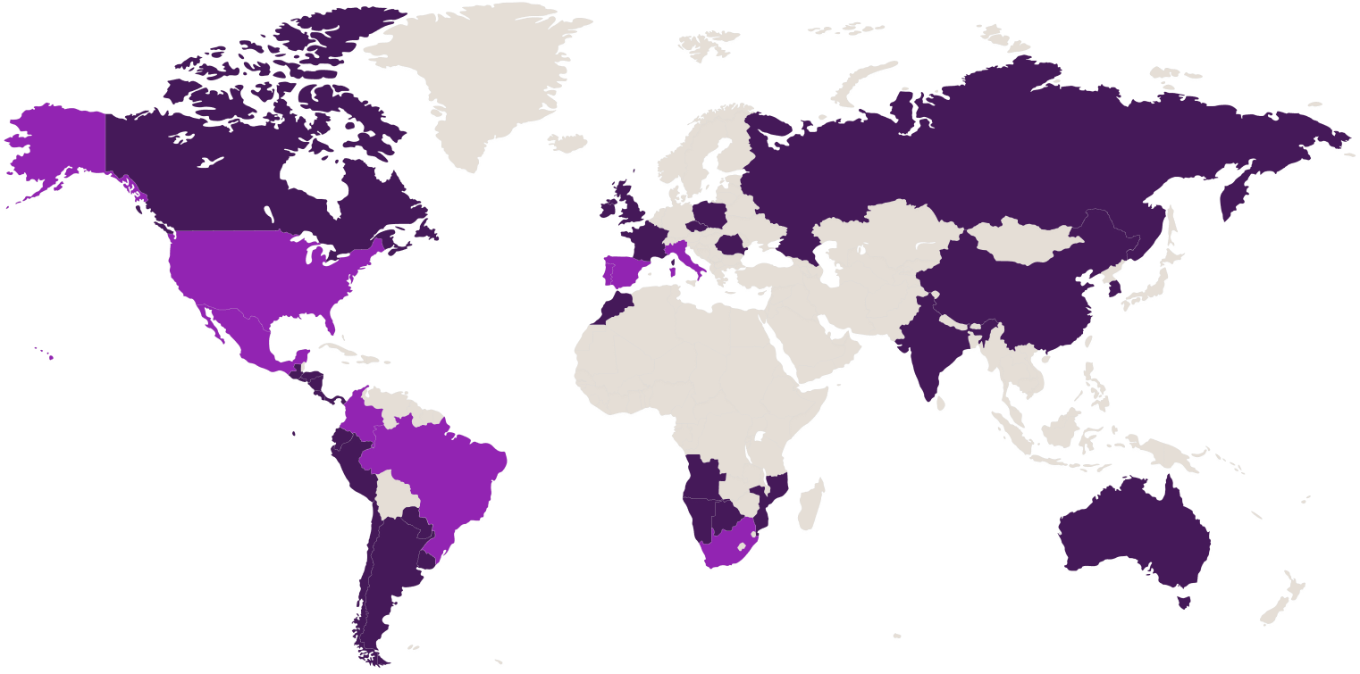
Global
Global Headquarters
Brazil
Headquarters International
Portugal
United States
Spain
Support
Brazil
Colombia
Spain
India
Mexico
Peru
Portugal
Platform Operating in 43 Countries
South Africa
Angola
Argentina
Australia
Belgium
Bolivia
Brazil
Cape Verde
Canada
Chile
China
Colombia
South Korea
Costa Rica
El Salvador
Ecuador
Spain
France
Guatemala
Netherlands
Honduras
Hongkong
India
England
Ireland
Italy
Luxembourg
Morocco
Mexico
Mozambique
Namibia
Nicaragua
Panama
Peru
French Polynesia
Poland
Portugal
Czech Republic
Romania
Russia
Sri Lanka
Uruguay
USA
Development
Brazil
Spain

Slide 6

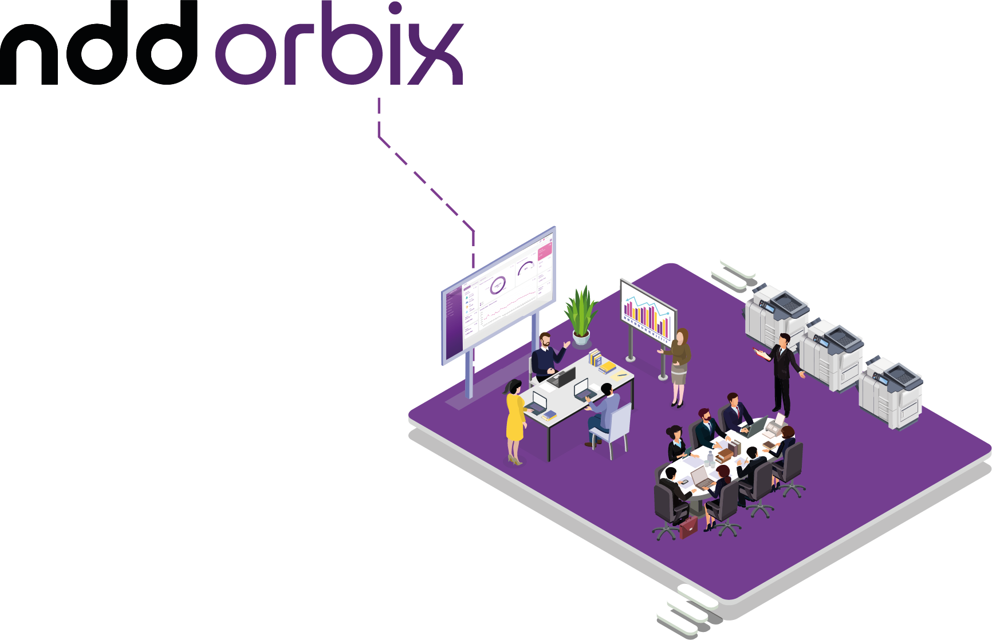
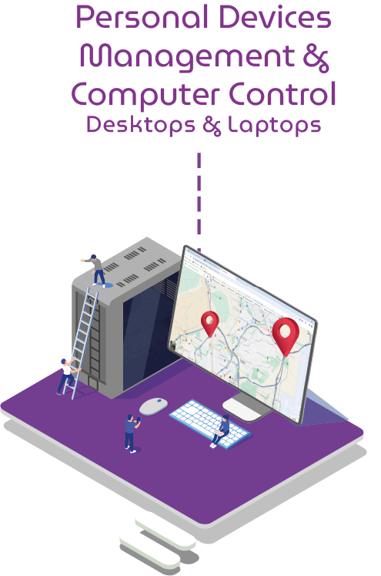
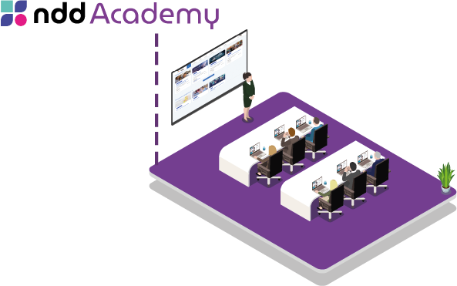

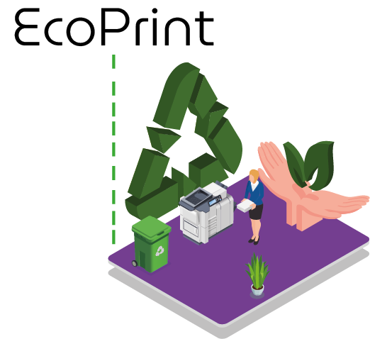
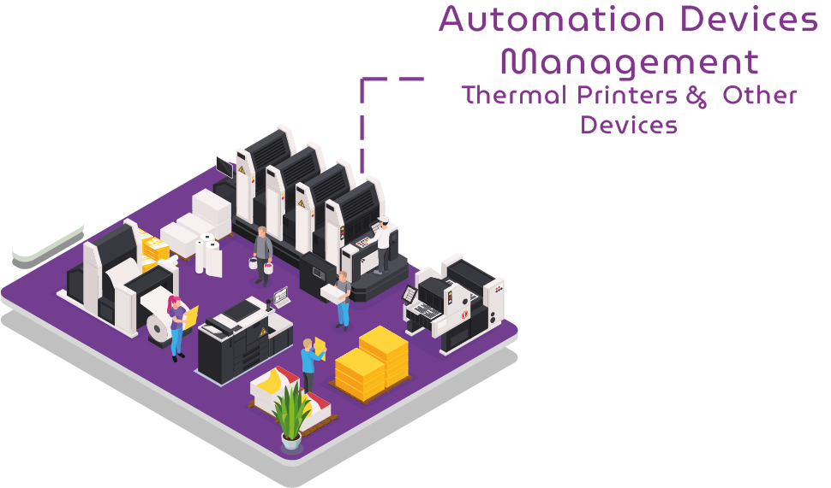
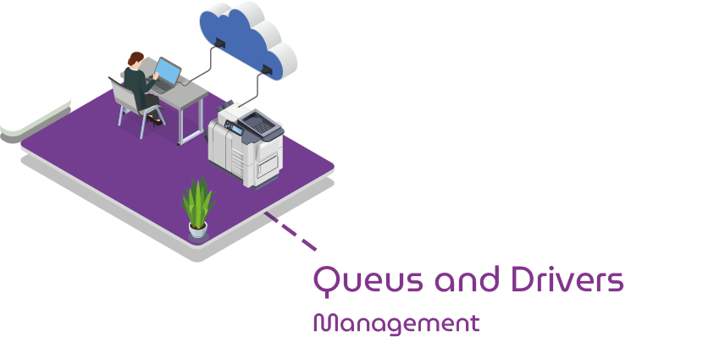
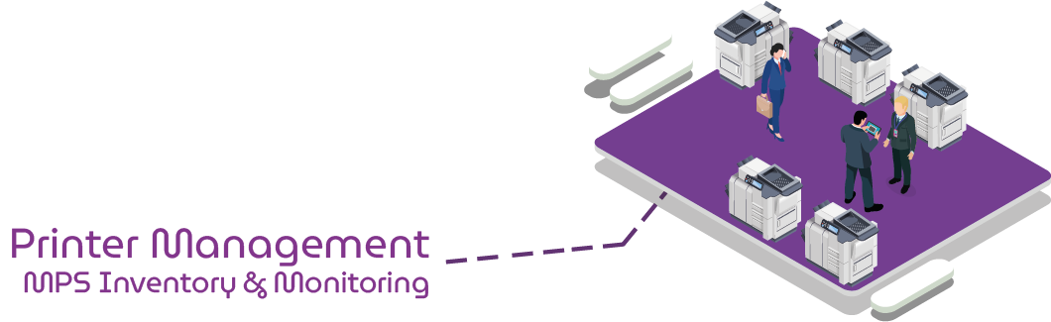
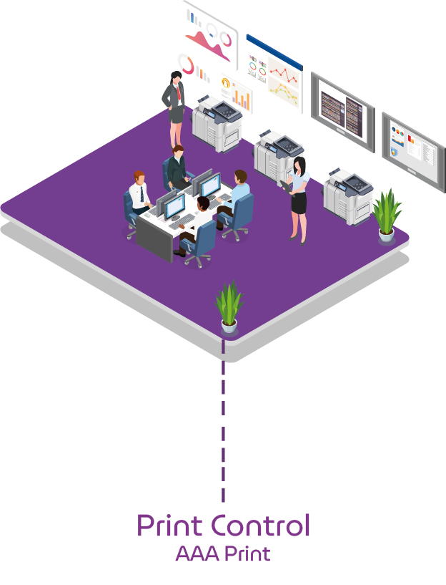
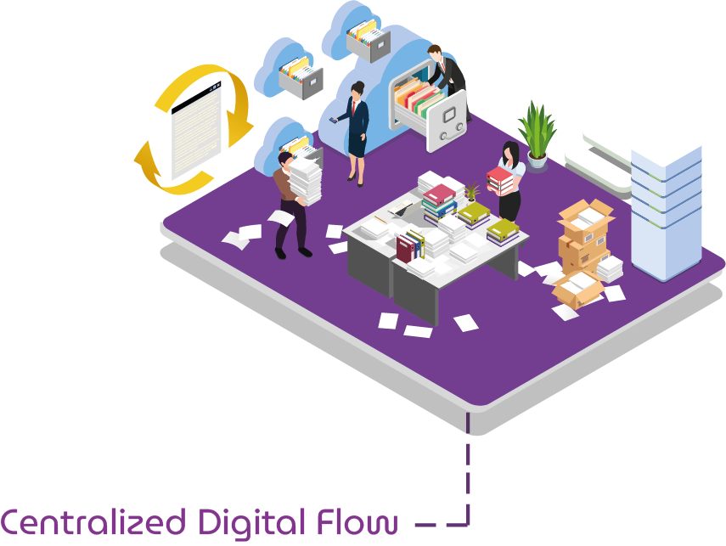
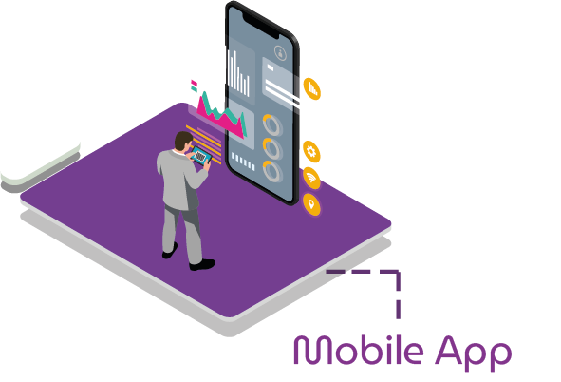

NDD created a platform
to help overcome these challenges
NDD Orbix is a high available platform, SaaS​ and cloud enabled, aimed at manufacturers, integrators and print service providers, Workspace and Workplace as a Service. It monitors and manages multiple devices and services transforming data into strategic insights to increase productivity, reliability and intelligent operations; reducing costs and enhancing revenues.

Slide 7

Platform
Services Devices Health
User Efficiency
Modules
Platform action pillars for different managed
Automation Devices Management
Personal Devices Management
Print Control
Computer Control
Printer Management
Printing device management​​
Management of multiple devices that are part of the Workspace
Management of desktops and laptops that are part of the Workspace
Management and Governance of printing and scanning jobs
Software and vulnerability management and monitoring
Features
Printer inventory and monitoring​
Accounting Management​
Supply Management​
Intelligence Predictive Supply​
Administration Remote Queues​
ECOPRINT
Label Printer Inventory and Monitoring​​
Collector Inventory and Monitoring​
Odometer Management​
Supply Management​
Intelligence​ Predictive Supply​
Computer Inventory and Monitoring​
Device Inventory and Monitoring​
Geolocation
Job Accounting by user of print and copies and Management​
Policies and Quotas
Accounting and Authentication Embedded
Scan to User
Digitization WorkFlows​
Pull Printing and Secure Release
Printing and retention in cloud
Software Inventory and Monitoring
Geolocation Advanced
Vulnerability Monitoring​
Feature in each module .
Essentials
Foundation of the platform architecture that underpins all you modules
Business Analytics
Report Generator
Customizable Dashboards
Integrations API
Alerts and Workflow
User Identification and Access Management
Management
Remote Installations

Slide 8







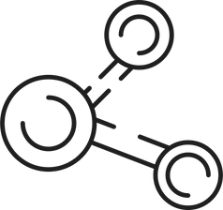



NDD Orbix Platform Differentiators
LOWER DISCONNECTION RATE
PRINT GOVERNANCE AND ACCESS CONTROL
INCREASED PROFITABILITY
Lowest disconnection rate on the market, ensuring continuous monitoring of devices . This ensures total control while​ others solutions yet present disconnections of up to 30%. Everything that using Unique AGENT .
20% savings on consumables without compromising quality. In addition to managing devices, the platform enables the management of the services that these devices perform, increasing efficiency and optimizing resources.
Strict governance over who can print and where, ensuring permissions align with company security and usage policies.
REDUCES IMPLEMENTATION COSTS
MONITORING AND SECURITY
INCREASE IN SALES
Remote and fast installation of print queues, ensuring drivers are always up-to-date and secure. This speeds up operations and reduces the need for manual maintenance, especially in environments with a large number of devices.
The platform also monitors usage patterns and behaviors, providing a strategic view of the device fleet. For desktops and laptops, it includes real-time geolocation, software and hardware inventory, and vulnerability monitoring.
The Platform's suite of solutions enables suppliers to expand their business with customers by offering additional security and cost control options, such as security policies, print quotas and robust printing infrastructure with Pull Printing.
ELIMINATION OF FALSE ALERTS
SUPPORT FOR USB AND MULTI-DEVICE DEVICES
OPTIMIZATION IN THE USE OF CONSUMABLES AND SUSTAINABILITY
Our intelligence eliminates false alerts regarding consumption, toner and other supplies, reducing unnecessary shipments and optimizing resource replenishment.
We are the only multi-brand platform on the market with a guarantee to manage USB and other devices, being the choice of manufacturers for projects involving these types of equipment.
We maximize the use of consumables by combining end-of-life alerts with load and production, which reduces waste by up to 20%. The platform also monitors environmental impact indicators, contributing to ESG practices.

Slide 9







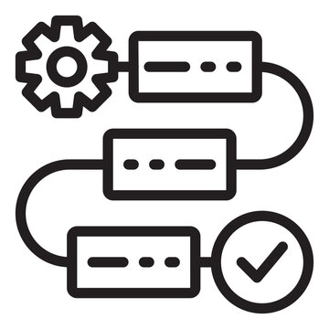

Technical Benefits NDD Print360
Multivendor Support
Resellers that work with different manufacturers need to offer customer a single user experience across different platforms.
Accounting Accuracy
Accounting directly from the devices and not from the spooler makes NDD the most accurate technology in the market.
Easy Deployment
It is possible to pre -install NDD Print360 on the lab. One unique Agent for Monitoring and Pull Print.
USB Monitoring
Possible to monitor USB connected devices. Easily track all your connected devices in a single platform.
Less Infrastructure
Pull Print without Print Servers and Pull Print without Server (light version) are available to save high infrastructure costs.
High Redundancy
Best technology available in the market for managing redundancy, cache in memory
Unique Architecture
Flexible architecture that can be installed in a local, hybrid or cloud environment.
Digital Workflows
Personalized workflows with capture of metadata on the screen and OCR. Integrations with DMS/ERP/CRM solutions.
Mobility
Email Print, Releaser Web, QR Code & Mobile app (IOS, Android)

Slide 10


Reduce costs
Challenge in reducing operational costs, eliminating unscheduled device shutdowns and ensuring uninterrupted process execution.
Device deployment
Challenges in installing, monitoring and integrating devices, requiring training and frequent manual interventions.
The challenges of managing digital space
and the ecosystem
of devices,
resources and services
ESG practices
Alignment with environmental, social and governance practices, with a focus on obtaining environmental data and reducing impact.
Consumables management
Control and efficiency in the use of consumables, avoiding waste and replacement problems.
Operational efficiency
Need to optimize processes, reduce waste and increase agility with minimal interventions.
New sources of revenue
Exploration of new value propositions and identification of additional revenue opportunities within the end customer.
Ensure an efficient and profitable digital environment for device and service providers that make part of the Digital Workplace is challenging and requires management and monitoring excellence, in addition to solutions innovative to offer one experience exceptional and meet to the end customer expectations​
Billing process
and after-sales
Difficulties with billing and contractual adjustments, in addition to data flow and billing problems that impact profitability.
Customer experience and satisfaction
Improved usability and faster response to failures, ensuring devices are always operational.
Differentiation of offers
Need to adjust solutions and differentiate offers to meet the specific needs of each client.
Notes:
1.7.2013
1.7.2013
‹#›
‹#›

Slide 11
Main Platform Attributes
High availability, Efficiency and Security
Optimization, Continuous Innovation and Sustainability
Increased Profitability and Cost Reduction
“24/7 platform without interruptions”
“Intelligence and new technologies
projecting confidence and
reducing costs”
“Improvement of
operating costs”
Continuous monitoring
Continuous connectivity
High availability
Team dedicated to supporting the business
Native or API integration in different environments
Intuitive interface
Less complexities and increased productivity
Strengthening processes
Machine Learning to maximize the use of consumables
Reduction of waste by up to 20%
Reduction of environmental impact with ESG best practices
The Central Management Platform and Operation of devices
Facilitation of control
Economy and Cost Optimization operational (no need for local infrastructure at the provider or end customer)
Reduction of allocated time teams in the process

Slide 12
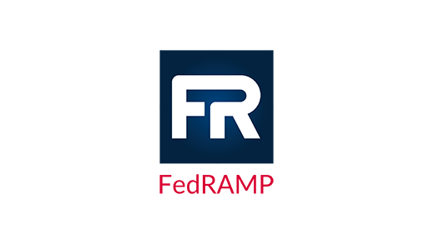
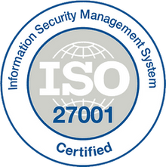




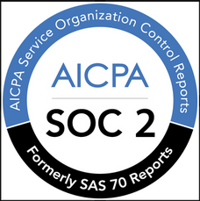
Security
Data center
NDD complies with the most diverse data security standards.
NDD Orbix benefits from Microsoft Azure’s extensive portfolio of security compliance certifications, ensuring that all data processing and storage practices meet the highest industry standards. This ensures security at every stage, from design to implementation and management of the infrastructure that supports our solutions. It uses Microsoft Azure data centers, which are renowned for their certifications and storage quality. The Azure environment complies with European Union data protection regulations.
Hardware Usage and Network Security
Interactions with our NDD Print MPS software are done via secure HTTP with TLS. The primary domain is authenticated by a Verisign certificate. No shared servers are used.
Data encryption
Hard drives and backups are encrypted and can only be restored with keys stored off-site, preventing data loss.

Slide 13

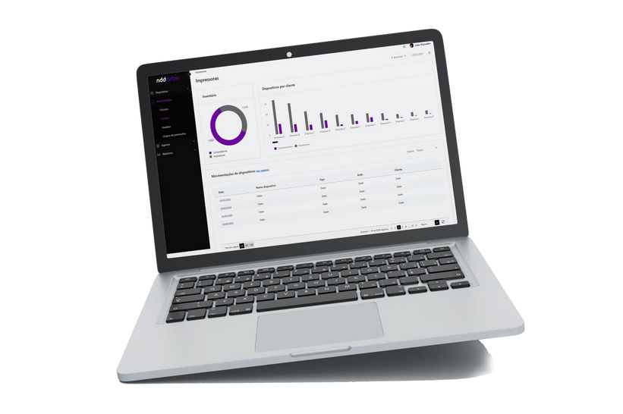
Benefits and Gains
Active CAPEX Management: Percentage of device life extension by up to 20%.
Advanced Logistics Control: Success rate in predicting stock and input replenishment exceeds 90% .
Higher Service Availability: Service availability percentage above 99.8% .
Ease of Integration with Internal Systems: Integration time with the client's internal systems reduced by an average of 15%
Unified, Self-Updating Installers: Reduced average device installation and update time by up to 32%.
Information Security: Percentage of security incidents prevented by proactive protection between 10% and 15%.
Value Generation for the End Customer: Level of satisfaction of the end customer with the service provided: NPS +85
Sustainability and ESG Compliance: Significantly reduce carbon emissions and waste associated with the use and disposal of devices.
Notes:
1.7.2013
1.7.2013
‹#›
‹#›

Slide 14

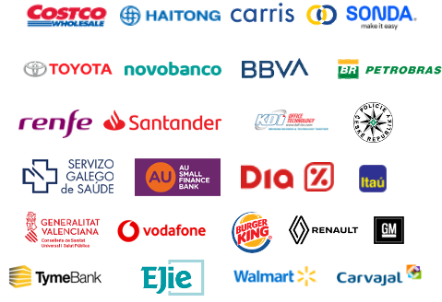
Some of the companies that use NDD platforms and solutions

Slide 15
ndd.tech

