Slide 1
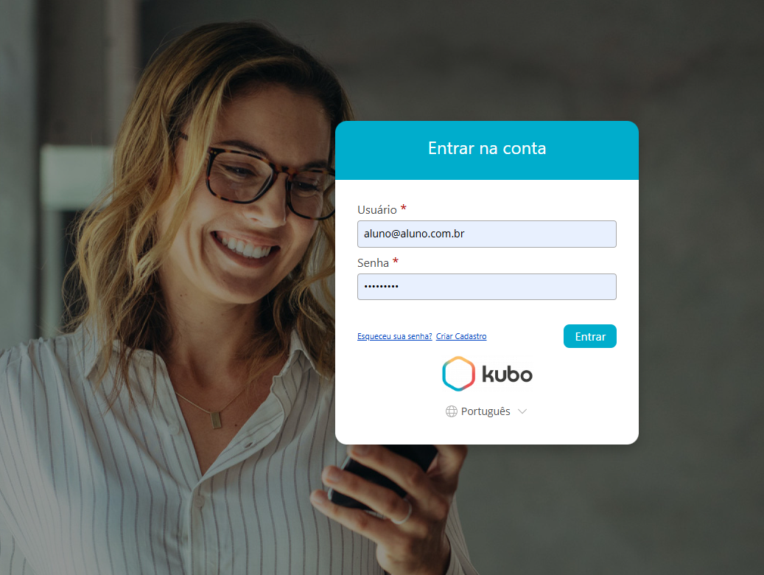

Corporate Education and Knowledge Management

Slide 2
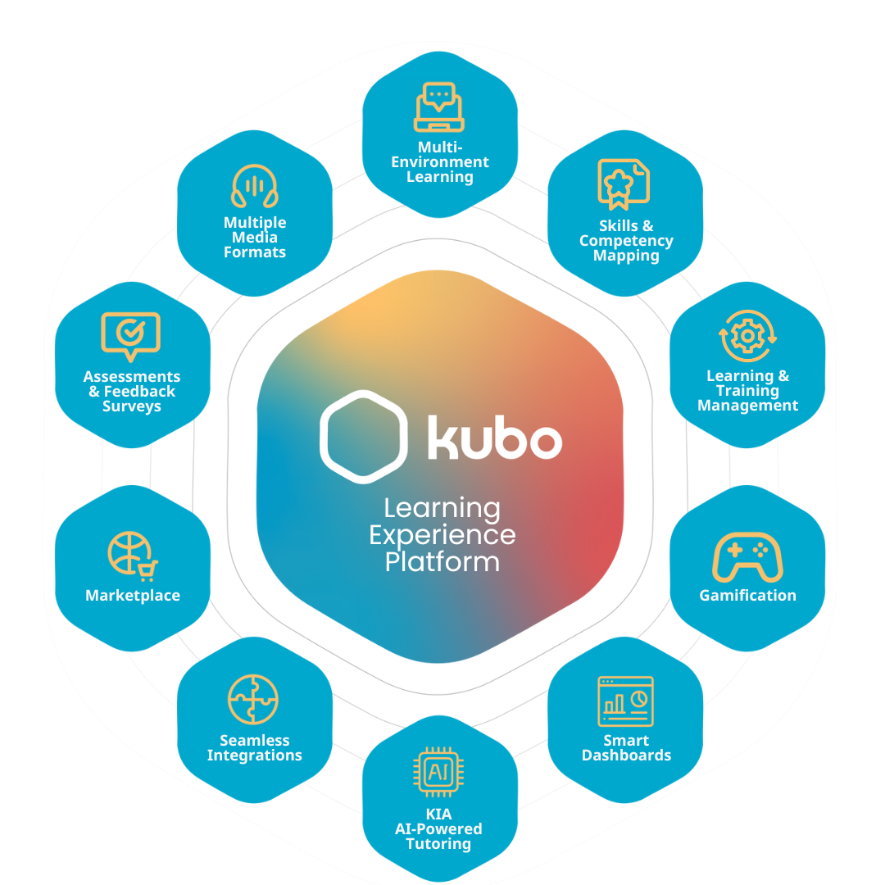
Corporate
Education Management
Platform
Kubo is an LXP (Learning Experience Platform), fully cloud-based and white-label, designed to manage learning processes and knowledge sharing within organizations.
Make it simple! Engage, develop, and build more productive and specialized teams with ease, using a platform that guides your corporate education.

Slide 3
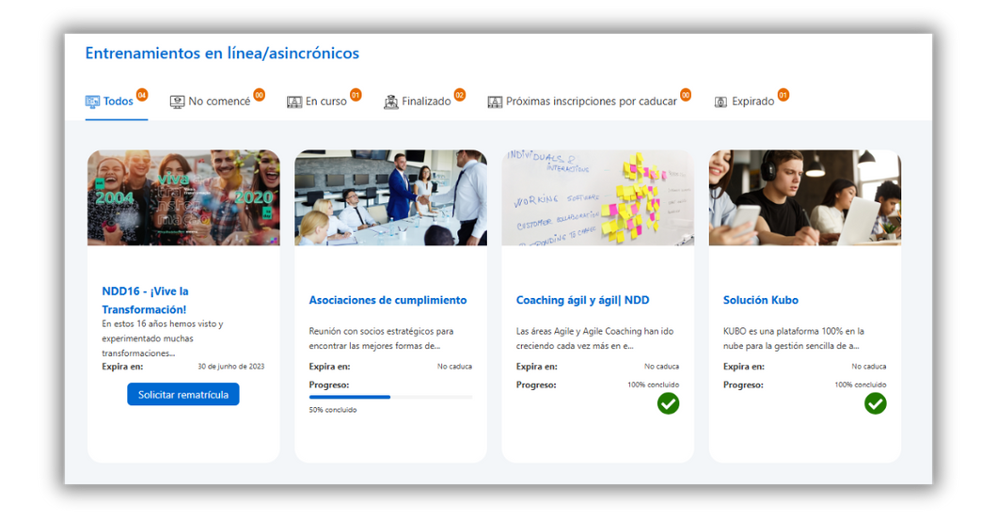
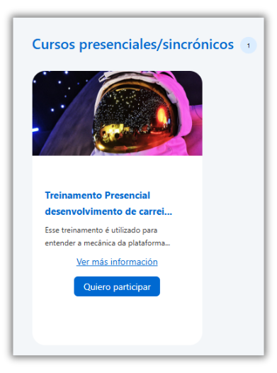
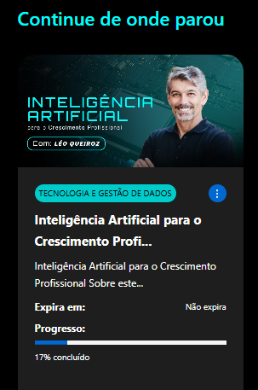

Solutions that integrate and simplify
Management of Online, Hybrid, and In-person Training: Combine classroom and online training, offering flexibility and a complete, interactive experience.
Automation of enrolments, deadlines, and certifications: Eliminate manual tasks, simplify access to content, and maintain full control over training schedules.

Slide 4
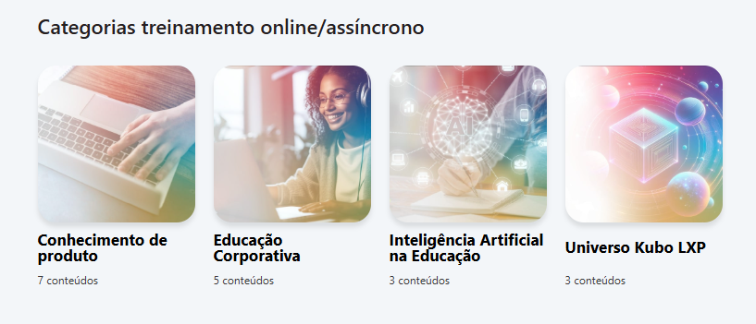
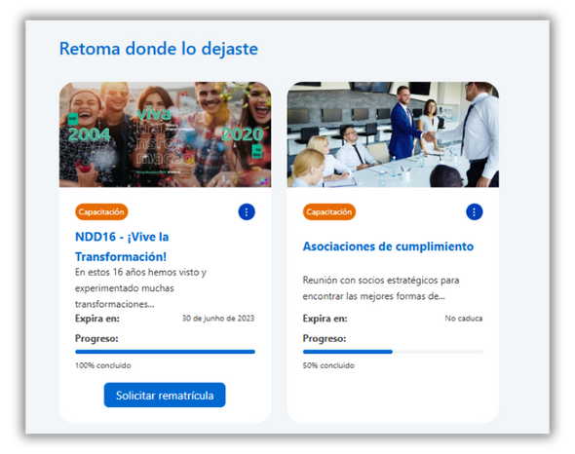
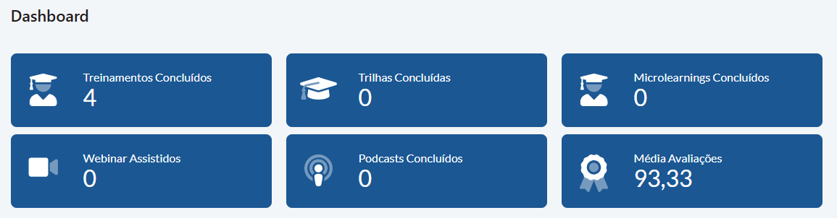
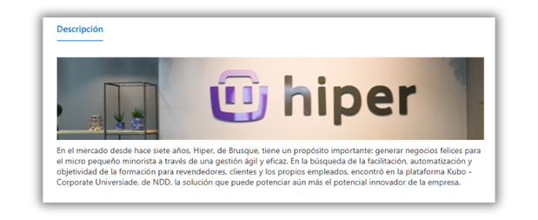
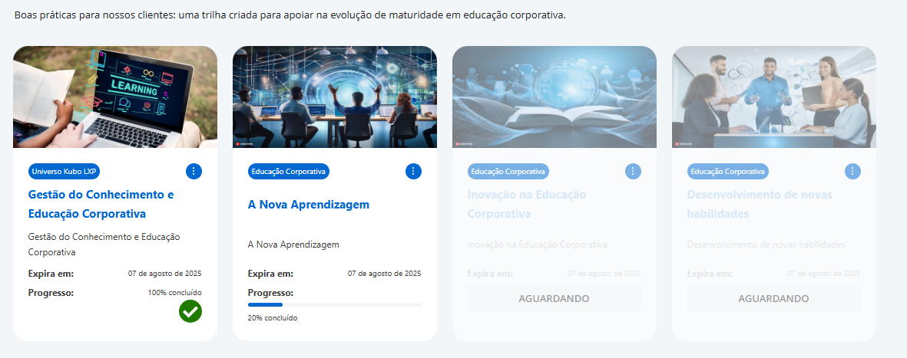
Personalization
for Every
Reality
Course and Learning Path Categorization: Direct the learning plan towards content aligned with strategic objectives. Ensure effective management of organizational knowledge.
Language Configuration: Adapt the learning environment to the linguistic needs of each employee (Portuguese, Spanish, and English). Other languages can be configured as required.

Slide 5
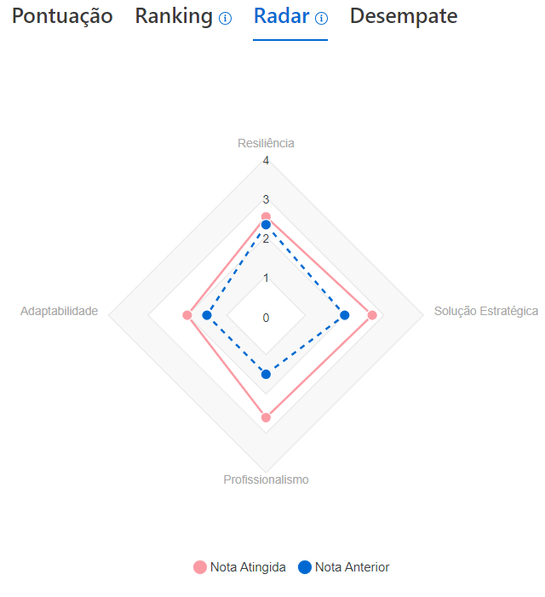
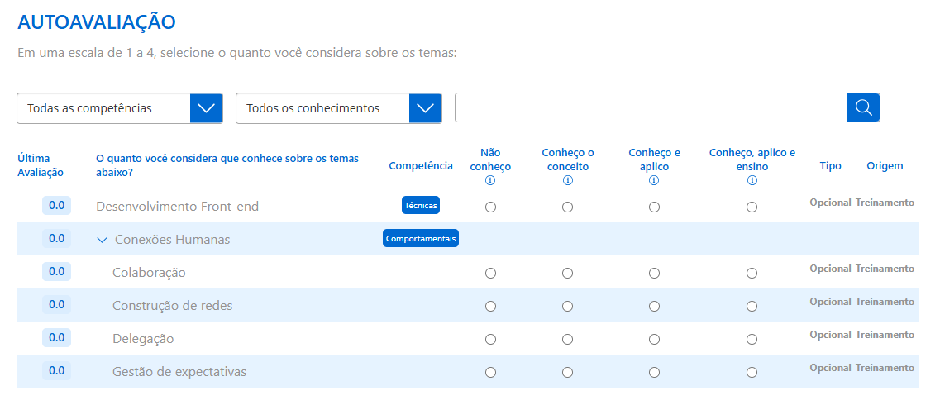
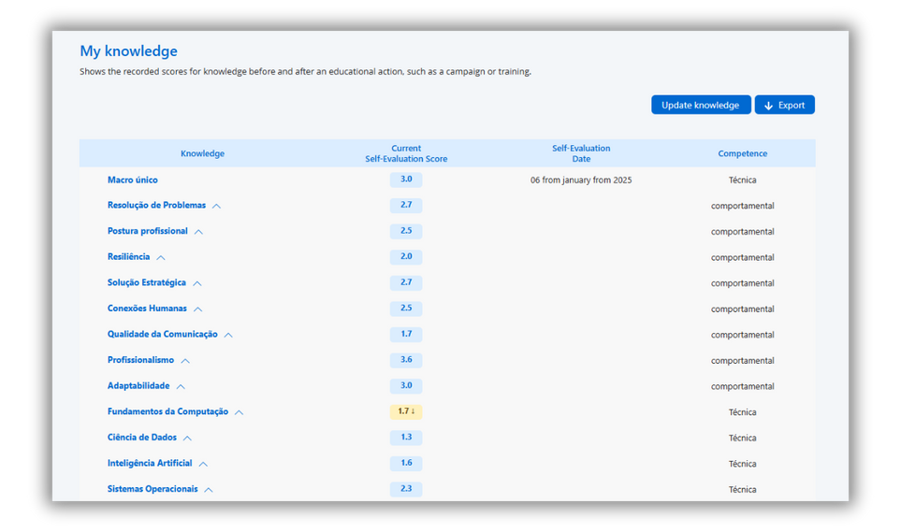
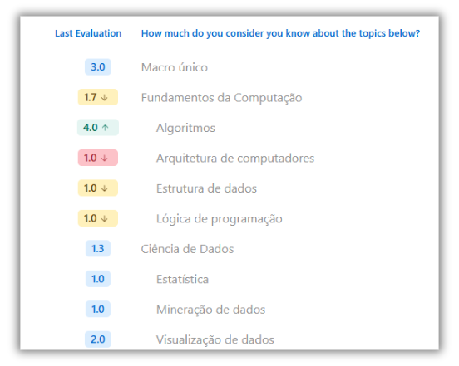
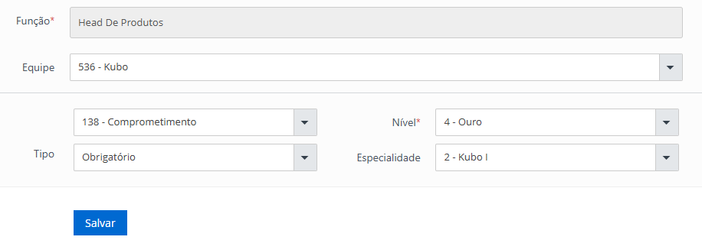
Kubo Skills: Targeted and Efficient
Training
Competence and Knowledge Mapping: Work with a focus on knowledge gaps and critical team skills. Plan precise and targeted learning initiatives using structured data. Automate your onboarding process.
Sector/Role Matrix: Set up mandatory training for specific profiles, roles, or departments, ensuring alignment and efficiency. Increase effectiveness across your people development processes.

Slide 6
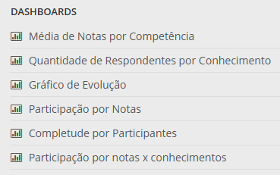
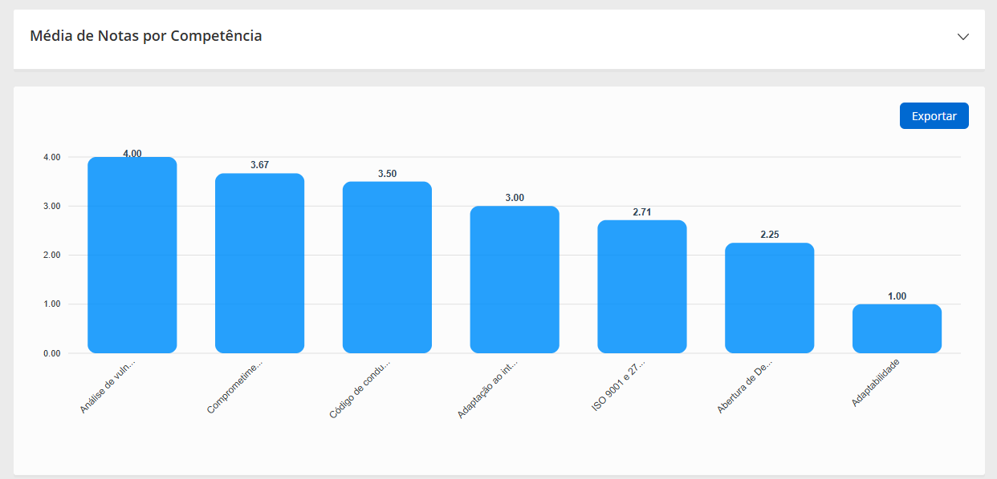
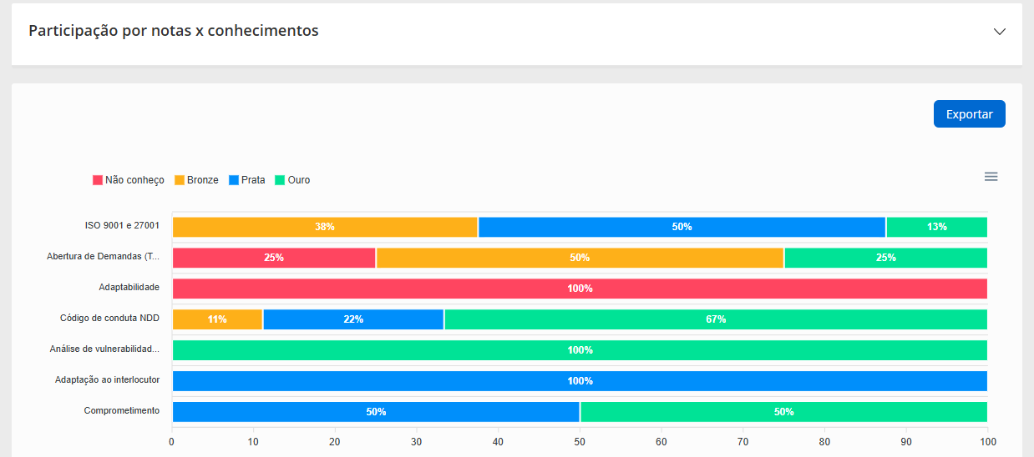
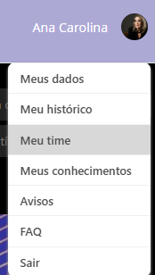
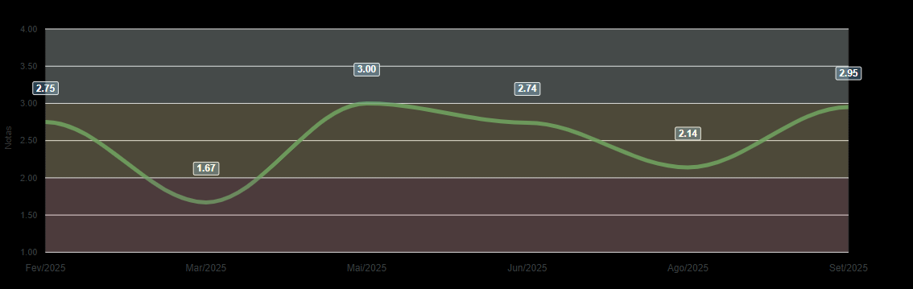
Kubo Skills: Tangible Results
Automated dashboards providing a real-time view of team knowledge and competences, enabling leaders to monitor the development of their teams and prioritize training initiatives.
Identification of specialists for future knowledge transfer, along with the monitoring of self-assessments in line with the defined schedule. Visualization of charts that can be individual, by team, by company, and more.

Slide 7
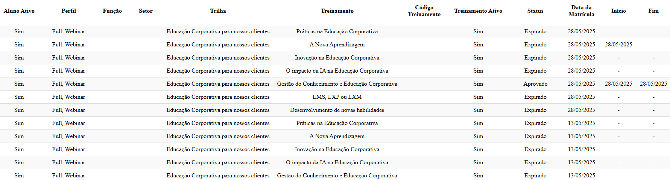
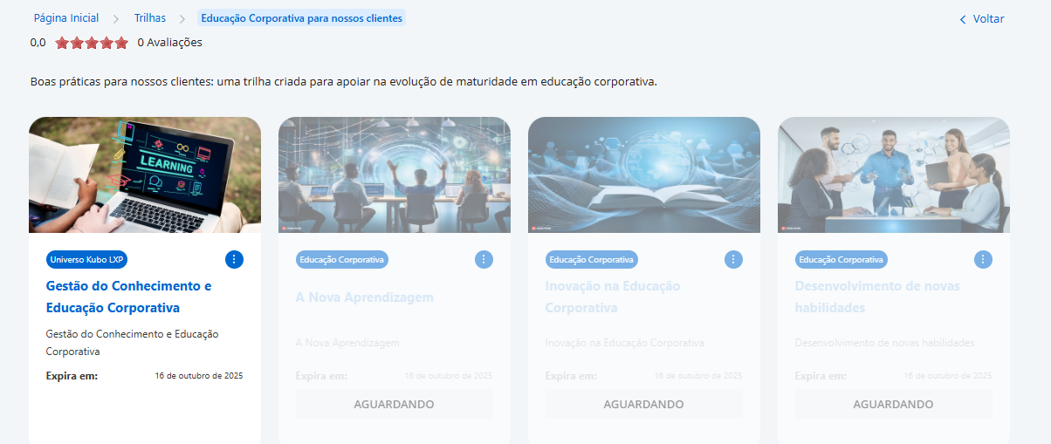

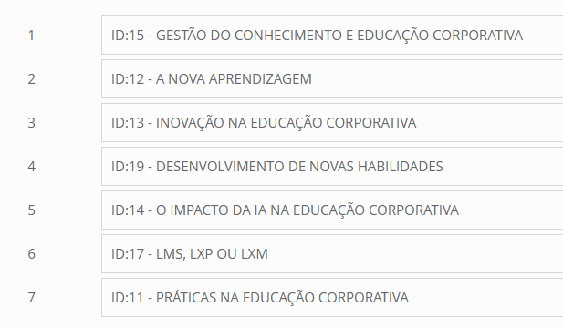
Learning Paths
to Guide Development
Incorporate the educational methodology into the design of your learning paths: Sequence topics, define mandatory steps, include intermediate activities for interaction, and track each participant’s progress percentage.
In addition to the learning path feature, create standalone training modules that can be recombined into different paths – for example, by knowledge area, role, or seniority.

Slide 8
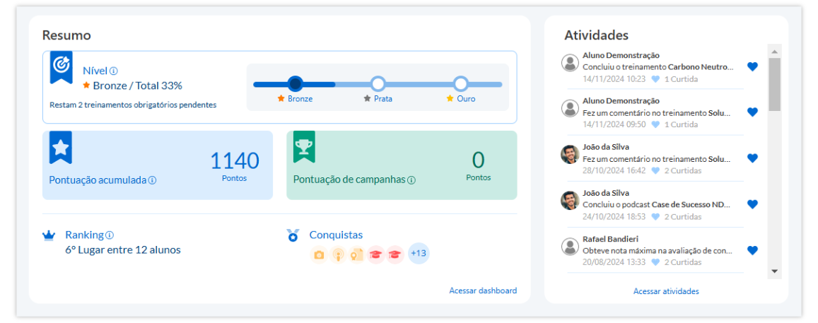
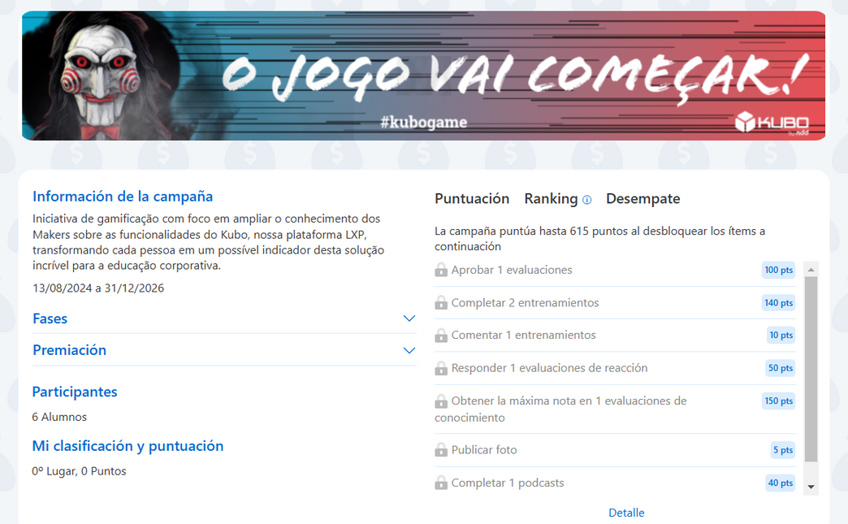
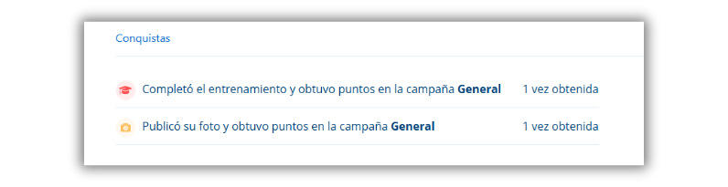
Learning that Engages and Motivates
Gamification Campaigns: Engage your team with learning-related challenges, using features such as leaderboards and rewards to turn learning into an immersive experience. Create parallel campaigns for specific audiences, with customized rules.
Social Interaction: Enrich the environment with banners, encourage discussions and knowledge sharing through interactive comments moderated by the learning manager. Automate communications aimed at learners.

Slide 9


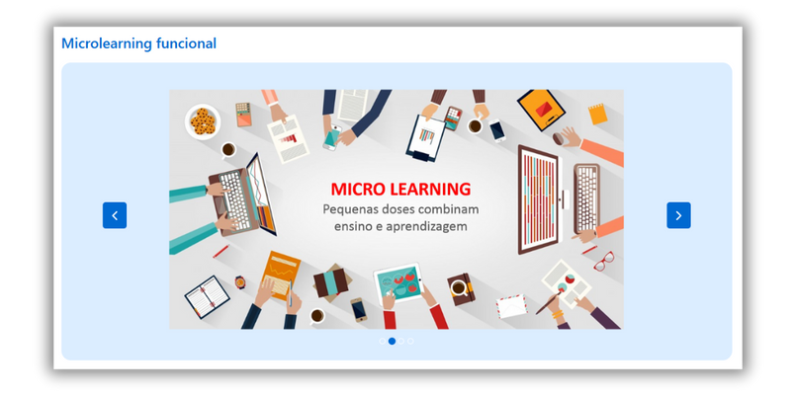

Experiences that Transform Learning
Webinars with Automatic Recordings: Host live events (both internal and external) and make the content available straight away. Ensure strong internal communication and keep a complete record.
Multimedia Experience: Use podcasts, micro learnings, libraries, and much more to cater for all learning styles. Integrate with Spotify, Panda Video, Vimeo, and YouTube. Encourage diverse learning approaches.

Slide 10
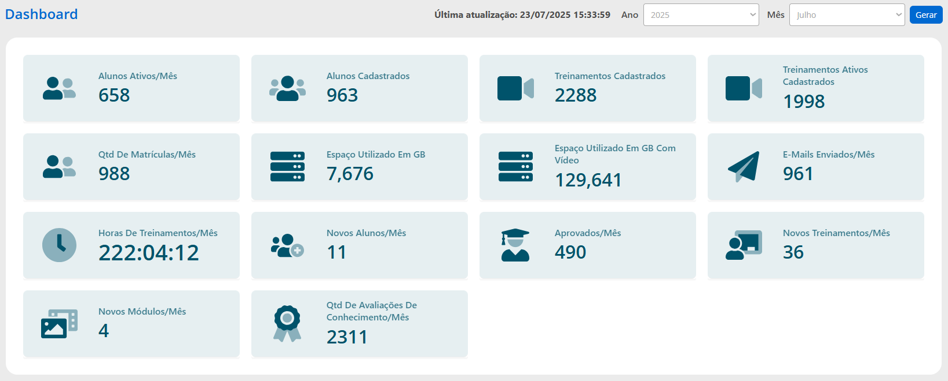
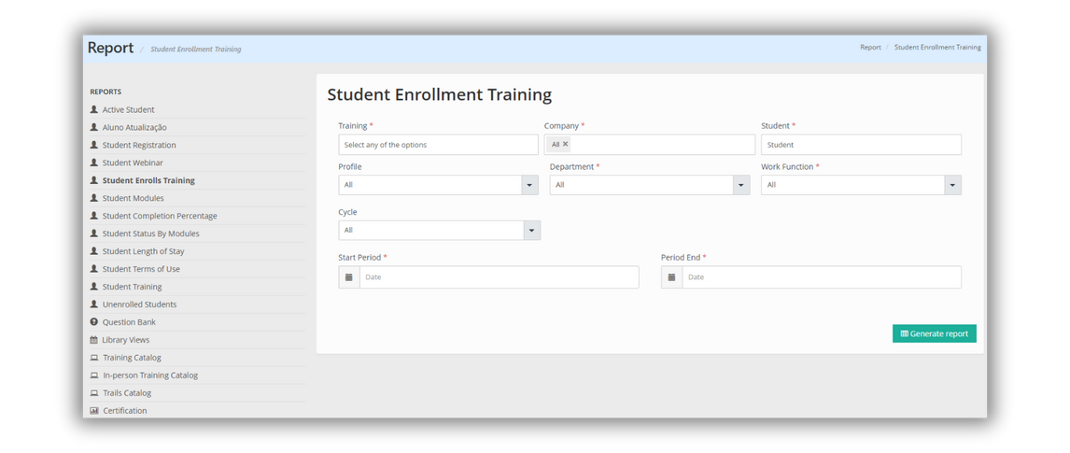
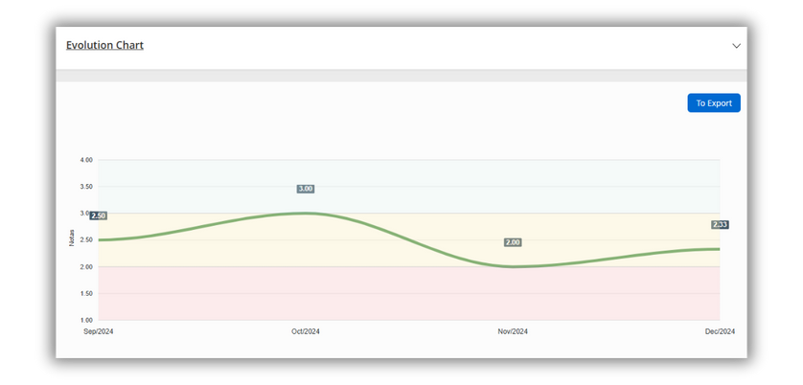
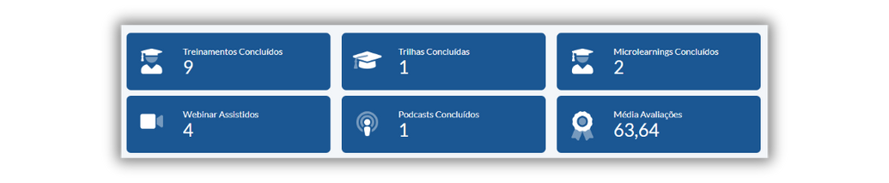
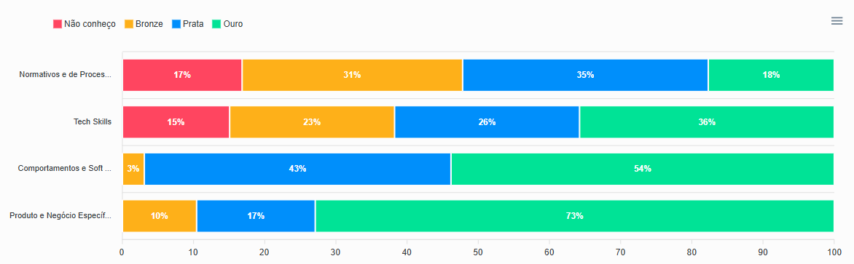
Smart Learning Management
Operational Dashboards: Track all data related to learners, courses, learning paths, companies, and gamification through available panels and reports.
Competence Management Dashboards: Monitor your team’s knowledge levels in real time and plan strategies based on reliable data.
60 customizable reports and queries, giving you full autonomy to analyze and work with data.

Slide 11

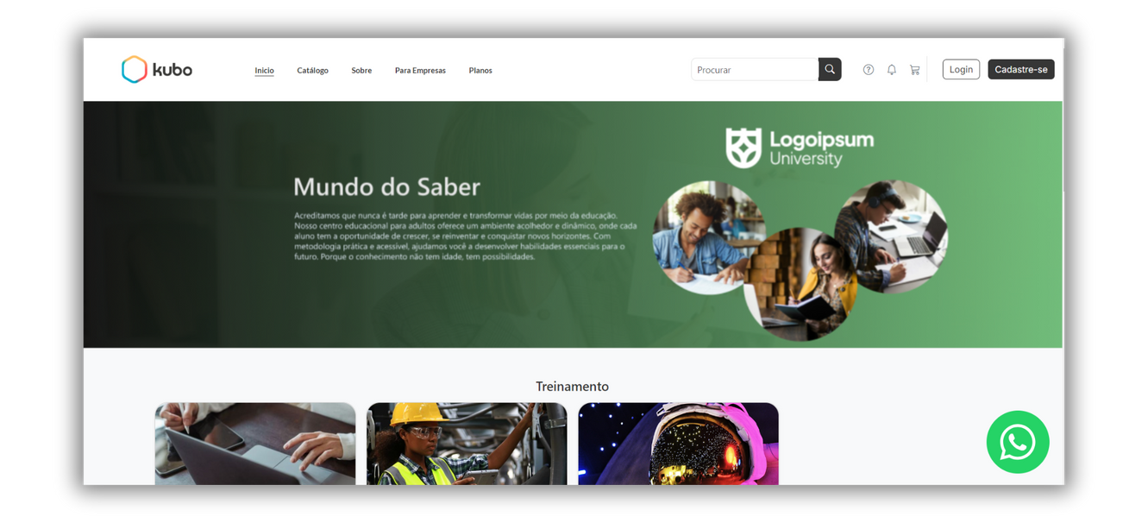
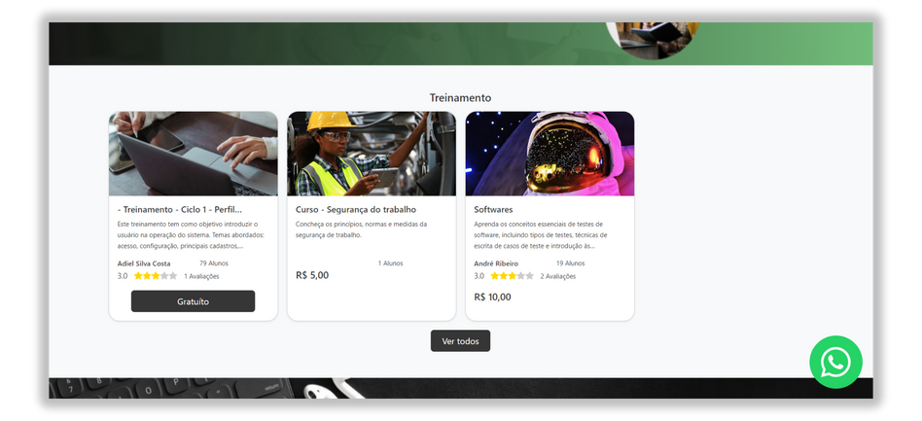
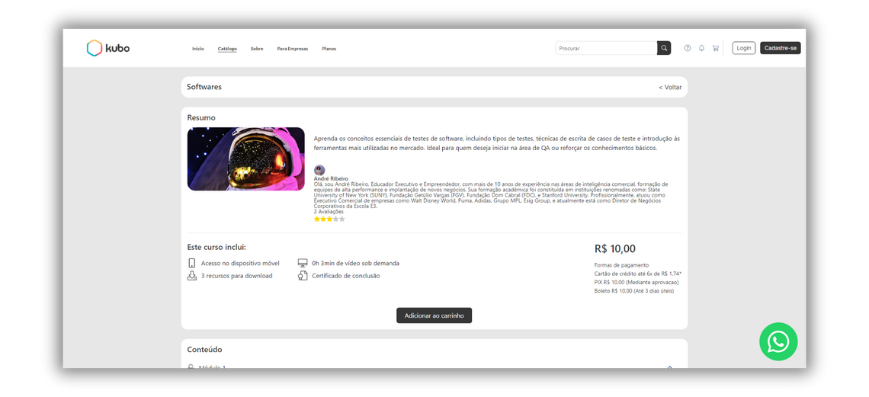
Add-on Module
Learning Content Marketplace
Generate Revenue: If you already invest in training for franchisees, partners, teams, or clients, turn this content into revenue for your business and sell it through the store integrated with the LXP. Customize your marketplace according to your branding.
Monitoring and Control: Manage purchases, track cancellations, identify best-selling models (individual courses or plans), and automate enrolments after purchase.

Slide 12
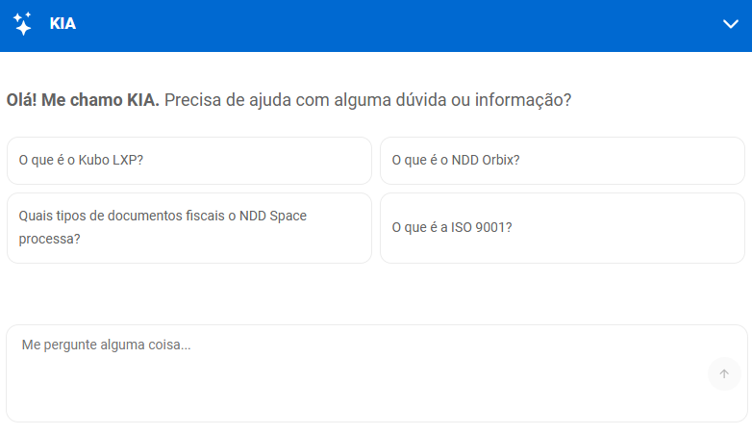

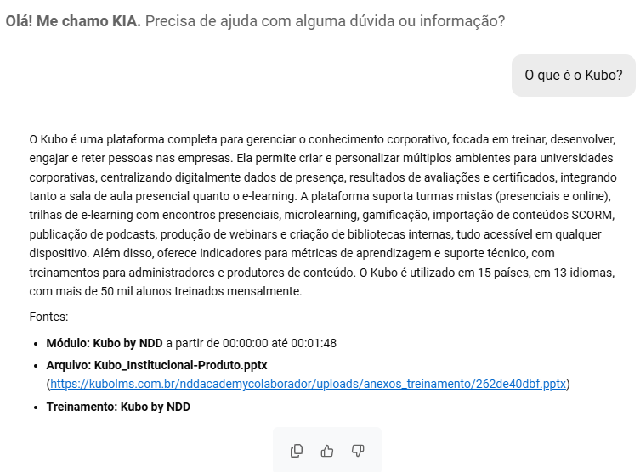

Add-on Module
Kia: Kubo’s Artificial Intelligence
AI-Powered Learning Tutoring: Through Kia, our Kubo AI, all your company’s knowledge stored within the LXP becomes available in seconds via the platform or through WhatsApp integration, enabling learners to ask questions or retrieve information at any time.
Kia is an AI trained with your own content to answer queries, support learning, and boost productivity. A tutor seamlessly connected to your training environment, transforming educational actions into just-in-time knowledge. And you can give it another name, according to your context.

Slide 13




As a reminder
100% Cloud-Based and Responsive
Multiple Workspaces
White Label
Integration API
Single sign on Azure
Multi-language (including English)
Embedded Educational Methodology
Data-Driven Management for Real Results
Help Centre and Knowledge Base
Implementation Onboarding
Customer Support Portal
Kubo Academy

Slide 14
Team members
Clients
Partners
Empower Employees. Drive Efficiency.
With Kubo, training your employees becomes a continuous process aligned with business goals. Transform knowledge into productivity and excellence.
Empower Clients. Achieve Results.
With Kubo, training your clients is no longer just an operational task – it becomes a strategy with real impact. Transform knowledge into value and elevate the experience of those who trust your business.
Turn Partners into Strategic Allies.
With Kubo, training partners, suppliers, channels, and franchisees is no longer a logistical challenge – it becomes an opportunity for growth. Ensure your network is fully equipped to drive the business forward.
To train all parties involved
Deliver an outstanding learning experience for your users across different devices, while ensuring full manageability of your processes.

Slide 15
Questions?

